Slide 1
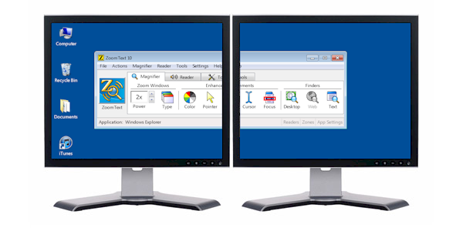
G4-9 DATA ANALYST GROUP
PRESENTED BY :
Richard Wanjue- Project Manager
Tabitha Juma- Project Planner
Jey Daniels- Content Developer
Ethel Rusere- Database Admin
Rachel Otieno-Business Analyst
Peterson Mugo- SSI Analyst
Richard Muhuwezi – Database Adm.
Lilian Njenga – data warehouse Eng.
Lydiah Omwenga – Database Analyst
RMG PROJECT ANALYSIS

Slide 2
Introduction - Company Overview.
Revolution Mortgage Group (RMG) is a Nationwide Leading mortgage company that cuts across a wide network of customers from first Time buyers, Real estate professionals to builders. RMG offers their services in Five different States within the US which are New York, Massachusetts, North Carolina, Texas and Florida and has been in the lending business for a long time.
RMG constantly reviews their services from time to time looking on ways of expanding and improving the services they offer to a wider customer base. As a result of the recent pandemic, a need arose for Mortgage loans.
A lot of employers changed the way they operate by having employees work remotely in a hybrid scene.
RMG saw a need to change the way they have always conducted their Mortgage lending and increase the availability and ease the process for approval.

Slide 3
RMG Group
FIRST TIME BUYERS
REAL ESTATE
LOAN
PURPOSE
REFINANCE
REVERSE MORTGAGE
CONSTRUCTION
OTHERS

Slide 4
PROJECT OVERVIEW
UNDERSTANDING THE PROJECT
DATA COLLECTION
CLEAN DATA
DATA PROCESSING
GRAPHIC VISUALIZATION
Understand the project need
Collect data from different sources
Clean data by checking that it meets all the requirements
Process all collected data and schedule jobs for new data
Present the data in graphical charts and diagrams

Slide 5
TIMELINE DELIVARABLES
AGENDA
Meeting with RMG Company Collection Process (online, Excel, Zillow)
Data Cleaning Process( SSIS Packages)
Test Cases(Business Rules)
Data Processing (SQL, Scheduling and Jobs, Data Modeling)
Results Interpretation (Power BI Charts and Tables
Nov 20th 2022
NOV 27th 2022
Dec 4th 2022
Dec 8th 2022
Dec 11th 2022
Data Collection (Extraction) and BRD Doc Preparation
Data Processing and Interpretation,
Members approval
Data Editing and Loading
Data Cleansing and Transformation
Project Presentation to RMG

Slide 6
What we did in the project
We employed the ELT process by extracting data from 3 source files which were collected in different formats. Loan applications made from the RMG website was stored in a SQL database, applications that were either emailed or faxed were collected and stored in a Comma Delimited File (CSV) and applications made from Zillow’s real-estate marketplace company were stored as Excel worksheet.
Below diagram illustrates our project Data Flow;

Slide 7
Data flow chart
Resend back to customer
Loan officers
Datawarehouse
RMG
Database
Staging Area
CSV /Zillow
Transform data SSIS
Business Rules
Excel
Email/Fax
Online/
RMG
Data Modelling
POWER BI
Extract data ETL

Slide 8
Data Cleaning/Cleansing Process (SSIS Package)
In the era of big data, cleaning or scrubbing your data has become an essential part of the data management process. Even though data cleaning can be tedious at times, it is crucial for getting accurate business intelligence (BI) that can drive your strategic decisions.
Cleaning your data results in many benefits for your organization in both the short and long term. It leads to better decision making, which can boost your efficiency and your customer satisfaction, in turn giving your business a competitive edge. Over time, it also reduces your costs of data management by proactively removing errors and other mistakes that would necessitate performing analysis repeatedly.
If your organization claims to be data-driven, then data cleaning absolutely needs to be a foundational part of your data management process

Slide 9
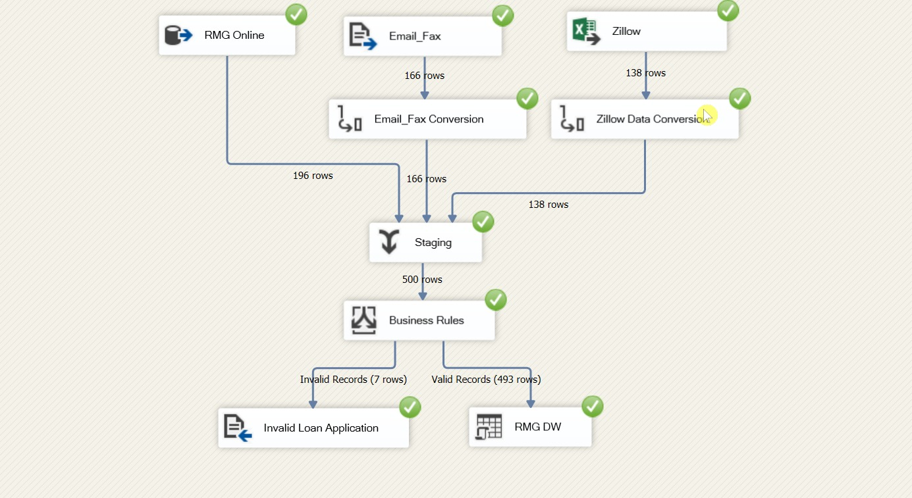
DATA CLEANING PROCESS

Slide 10
Test Case
Test case is a type of software testing that checks the schema, tables, data integrity and consistency. It may involve creating complex queries to load the Database and check its responsiveness.
Three different test cases were conducted;
All applications had a valid Social Security Number(SSN)
All applications had both First and Last Names
The credit score of all applications had to be valid (Lowest 300 and Highest 850)

Slide 11
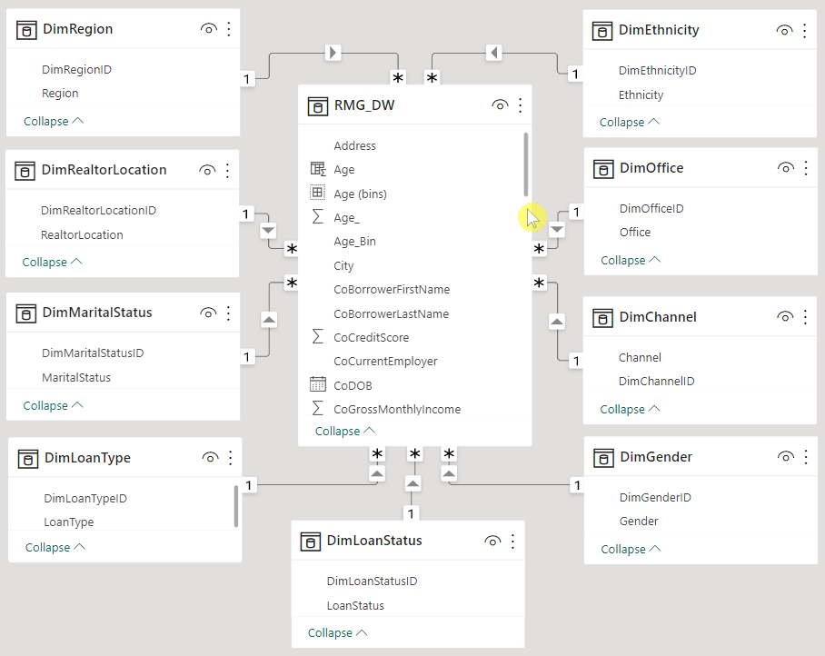
Project Data Model

Slide 12
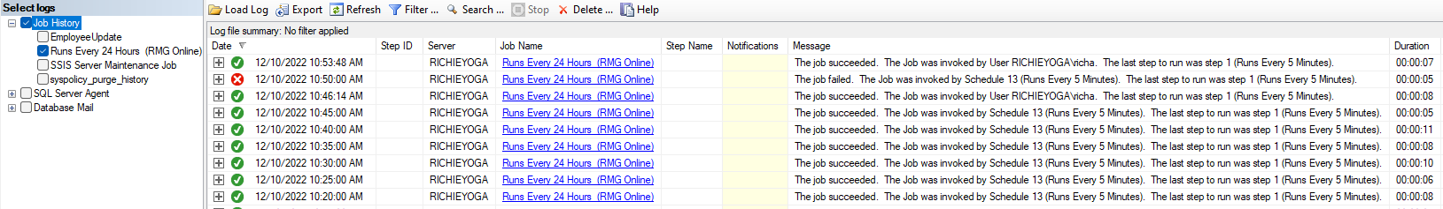
Job Scheduling

Slide 13
Project Database
Update/ Add Loan Applications
Power BI
Visualization
Stored Procedure
Avoid Duplication
Loan Update
JOB

Slide 14
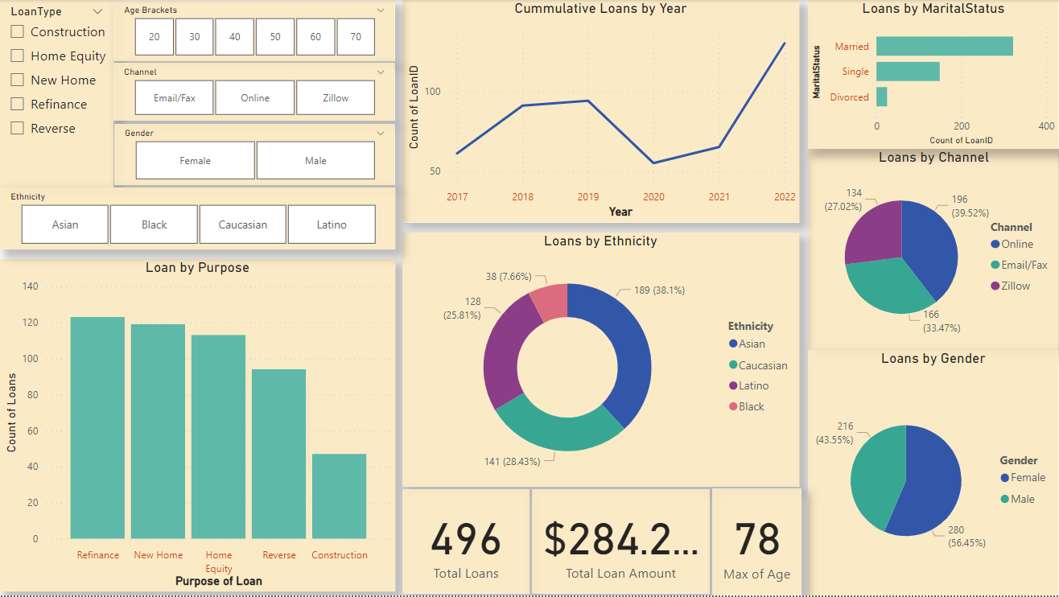

Slide 15
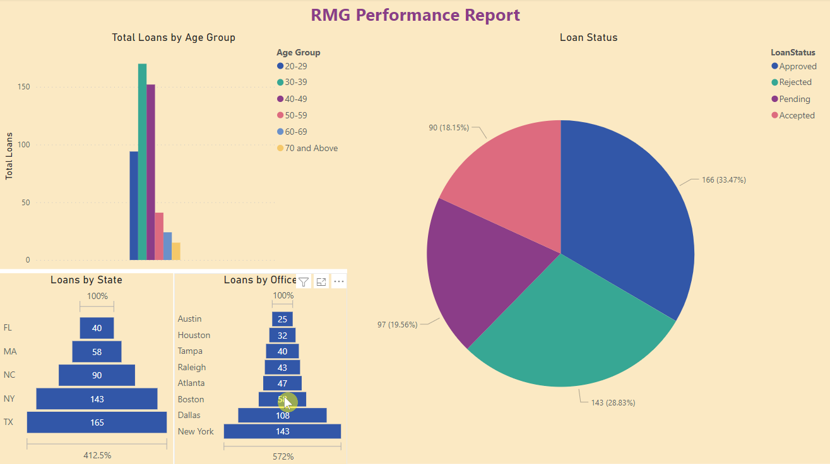

Slide 16
PROJECT CHALLENGES
Time and Budget limitations
Collecting adequate data
Data Analysis skills
Data integrity
Collaboration with stakeholders in timely manner
Data accessibility

Slide 17
Recommendations
Speed up approval process .
Marketing (Online)
Increase Budget allocation
Public sensitization (Educate)
Increase the number of offices to other states

Slide 18

VOTE OF THANKS
We wish to thank the stakeholders of RMG entrusting this project to the G4-9 to work on it.
Appreciation goes to the G4-9 project members for working tirelessly to ensure the project is a success.
A big thank you also goes out to our Professors Jacque and Edith for being our point of consultation.

Slide 19

QUESTIONS

